Slide 1
Lecture 31
Apple iPhone Platform,
Intro of iPhone and iOS,
UI Tool kit interfaces,
Event Handling,
Graphics Services,
Layer Animation

Slide 2
Introduction
iOS, which was previously called iPhone OS, is a mobile operating system developed by Apple Inc.
Its first release was in 2007, which included iPhone and iPad Touch.
iPad (1st Generation) was released in April 2010.
iPad Mini was released in November 2012.
Apple's latest mobile is iPhone 7 Plus and launched in September 2016.
Latest iOS version is 10.0.2 which launched on 23-SEP-2016.
Now, working on iOS 10.1 and it’s Beta version have been launched on 10-OCT-2016.

Slide 3
Features of iOS
Maps
Siri (It is Apple's voice-controlled personal assistant)
Facebook, Twitter, other social media….
Multi-Touch
Accelerometer (Sensor)
GPS
High end processor
Camera
Safari (Apple’s Web Browser)
Powerful APIs
Game center
In-App Purchase
Wide Range of gestures

Slide 4
iOS - Environment Setup
iOS - Xcode Installation:-
Download the latest version of Xcode from https://developer.apple.com/downloads.
Double click the Xcode file.
You will find a device and opened it.
There will be two items, Xcode application and the Application folder's shortcut.
Drag the Xcode and copied to your applications.
Now Xcode will be available as a part of other applications from which you can select and run.
Note:- You also have another option of downloading Xcode from the Mac App store.

Slide 5
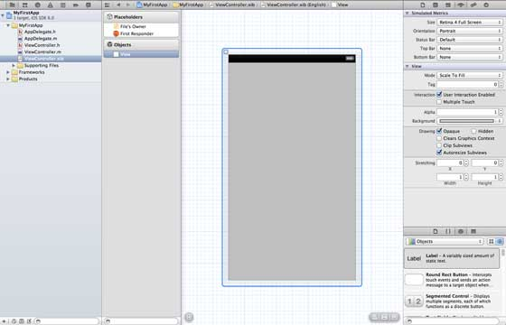
iOS - Environment Setup
2. Interface Builder:-
Interface builder is the tool that enables easy creation of iPhone and iPad apps.
You have a rich set of UI elements which use for app development.
You just have to drag and drop into your UI view.

Slide 6
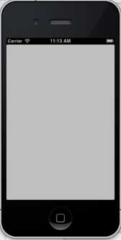
iOS - Environment Setup
3. iOS Simulator:-
An iOS simulator actually consists of two types of virtual devices, namely iPhone and iPad.
It basically use for test and run your apps.

Slide 7
Development Language in iOS
The language used in iOS development is objective C.
It is an object-oriented language.
The file where the class is declared is called the interface file.
The file where the class is defined is called the implementation file.
Data Types in Objective C :- NSString, CGFloat, NSInteger, BOOL.
NSLog :- used for printing a statement. Syntax:- NSlog(@"");

Slide 8
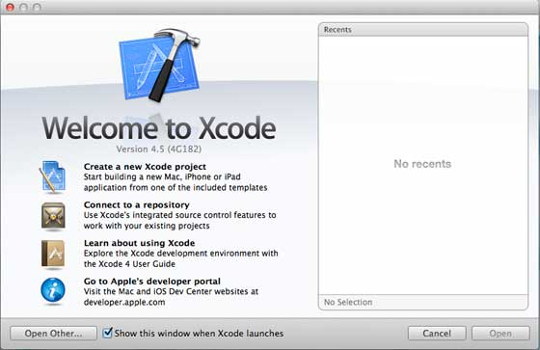
First iPhone Application
Step 1 − Open Xcode and select Create a new Xcode project.

Slide 9
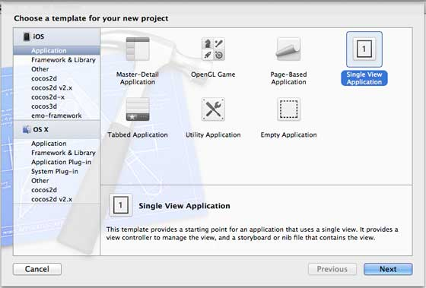
First iPhone Application
Step 2 − Select Single View Application.

Slide 10
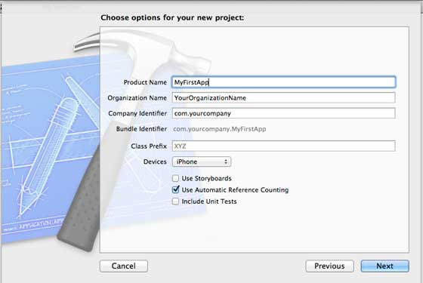
First iPhone Application
Step 3 − Enter the product name as name of the application, organization name, and then the company identifier.
Ensure that Use Automatic Reference Counting is selected in order to automatically release the resources when it goes out of scope and Click Next.

Slide 11
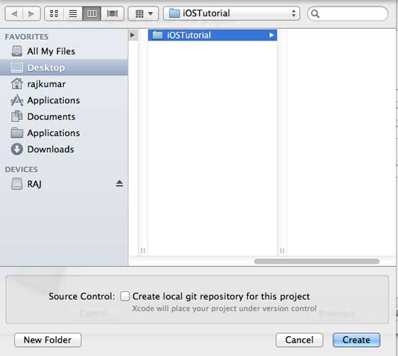
First iPhone Application
Step 4 − Select the directory for the project and select create.

Slide 12
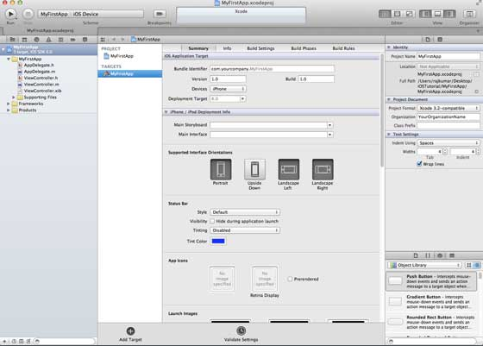
First iPhone Application
Step 6 − It will create a blank project and now you can develop you app according to your need.

Slide 13
First iPhone Application
Step 7 − Now, select iPhone simulator in the drop down near Run button and select run.
Step 8 − That's it. You have successfully run your first application. You will get an output as follow:

Slide 14
iOS Development Toolkit
Here is a list of best iOS Development Tools, Services, Frameworks and Libraries.
1. Tools:-
Continuous Delivery made easy using Fastlane.
Use PAW or Postman for testing and documenting.
Find memory leaks and much more using Instruments
Jazzy is a command-line utility that generates documentation for Swift or Objective-C
When working with Ruby or Python then prefer Atom over Xcode.
A great Plugin Manager for Xcode called Alcatraz.
Cocoa Pods is a dependency management system for iOS Apps.
If you want to sniff HTTP-Request from your iDevice use Charles.
Improve your Debugging with Chisel.
Turn drawings into code with Paint Code.
Icons8 App provides 23,400 Free Icons.
Pixelmator is a great Photoshop alternative for Mac OS.
Power JSON Editor is a great tool to edit and overview your JSON Files.

Slide 15
iOS Development Toolkit
2. Services:-
A modular plugin system for your iOS Apps called Fabric.
Testflight is a native beta test distribution framework.
SupportKit is a great messaging SDK.
Mobile Analytics with Mixpanel.
Use Trello to manage your private projects.
When working in a Team, then prefer using a tool like JIRA .

Slide 16
iOS Development Toolkit
3. Frameworks and Libraries:-
Networking in Objective-C made easy using AFNetworking.
Networking in Swift made easy using Alamofire.
AudioKit is a powerful audio processing and analysis framework.
FBTweaks is a great way to manipulate parameters at Runtime.
Realm is a great Core Data alternative.
Get auto completed resources like images, fonts in Swift projects using R.swift.
Visualize touches, gestures and long presses on your iPhone or iPad with COSTouchVisualizer.
SwiftLint is a tool that enforces errors and warnings directly inside Xcode.

Slide 17
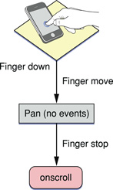
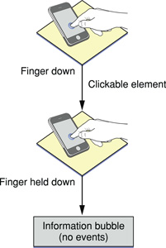
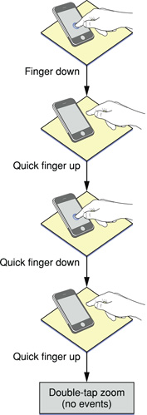
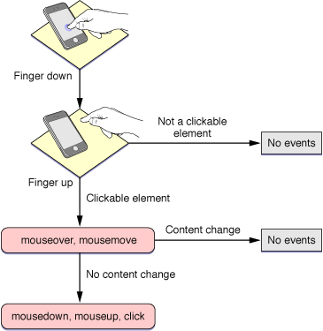
Event Handling in iOS
Events that occur when the user interacts with app or webpage on iOS.
One-Finger Events:-

Slide 18

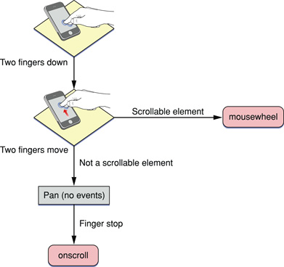
Event Handling in iOS
2. Two-Finger Events:-

Slide 19
Event Handling in iOS
3. Multi-Touch Events:-
Touch events are similar to mouse events except that you can have simultaneous touches on the screen at different locations.
A touch event object is used to encapsulate all the touches that are currently on the screen.
Each finger is represented by a touch object.
Multi-touch events in HTML for iOS web application:-
<div ontouchstart="touchStart(event);" ontouchmove="touchMove(event);" ontouchend="touchEnd(event);" ontouchcancel="touchCancel(event);" ontouchforcechange="touchForceChange(event);">
</div>

Slide 20
Event Handling in iOS
4. Orientation Events:-
An event is sent when the user changes the orientation of iOS.
By handling this event, you can determine the current orientation of the device and make layout changes accordingly.
For example, display a simple textual list in portrait orientation and add a column of icons in landscape orientation.
Syntax in HTML:-
<body onorientationchange="updateOrientation();">

Slide 21
Event Handling in iOS
5. Supported Events:-
Be aware of all the events that iOS supports and under what conditions they are generated. Below Table specifies which events are generated by Safari on iOS and which are generated conditionally depending on the type of element selected. This table also lists unsupported events.
Event | Generated | Conditional
mouseup | Yes | Yes
mouseover | Yes | Yes
mouseout | Yes | Yes
orientationchange | Yes | N/A
pagehide | Yes | No
pageshow | Yes | No
paste | No | N/A
reset | Yes | No
selection | No | N/A
submit | Yes | No
Event | Generated | Conditional
abort | Yes | No
blur | Yes | No
click | Yes | Yes
copy | No | N/A
cut | No | N/A
drag | No | N/A
drop | No | N/A
focus | Yes | No
mousemove | Yes | Yes
mousedown | Yes | Yes

Slide 22
Graphics Services in iOS
High-quality graphics are an important part of all apps.
iOS provides various technologies to help put your custom art and graphics onscreen.
You can use the standard views to deliver a high-quality interface quickly, or you can create your own custom views by using Graphics technologies.
Graphics technologies:-
UIKit graphics:- UIKit defines high-level support for drawing images and desire paths for animating the content of your views.
UIKit views provide a fast and efficient way to render images and text-based content.
Core Graphics framework:- Core Graphics (also known as Quartz) is the drawing engine for iOS apps.
This framework is well suited for situations where you want to render custom 2D shapes and images dynamically.

Slide 23
Graphics Services in iOS
3. Core Animation:- It is part of the Quartz Core framework.
It is a foundational technology that optimizes the animation experience of your apps.
UIKit views use Core Animation to provide view-level animation support.
You can use Core Animation directly when you want more control over the behavior of your animations.
4. Core Image:- It provides advanced support for manipulating video and still images.

Slide 24
Graphics Services in iOS
5. OpenGL ES and GLKit:- OpenGL ES handles advanced 2D and 3D rendering using hardware-accelerated interfaces.
This framework is traditionally used by game developers.
This framework gives you full control over the rendering process to create smooth animations.
GLKit is a set of Objective-C classes that provide the power of OpenGL ES using an object-oriented interface.
6. Metal:- Metal provides extremely low-overhead access and enabling high performance for graphics rendering and computation tasks.

Slide 25
Graphics Services in iOS
7. TextKit and Core Text:- TextKit is a family of UIKit classes used to perform fine typography, text management and advanced text manipulations.
Core Text is a lower-level C-based framework for handling advanced typography and layout.
8. Image I/O:- Image I/O provides interfaces for reading and writing most image formats.
9. Photos Library:- The Photos and PhotosUI frameworks provide access to a user’s photos, videos, and media.

Slide 26
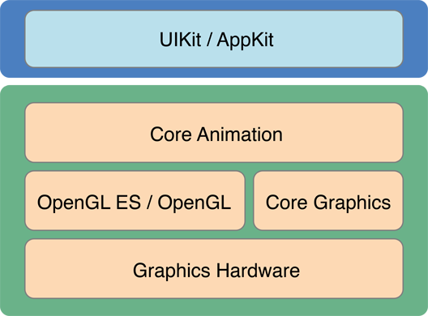
Layer Animation in iOS
Core Animation is animation infrastructure available on iOS that use to animate the views and other visual elements of your app.
Firstly draw a frame of an animation, then configure animation parameters (such as the start and end points) and tell Core Animation to start, Core Animation will do your work.

Slide 27
Layer Animation in iOS
The infrastructure provided by Core Animation makes it easy to create animations of your app’s layers.
Example:- Changing the size of a layer’s frame rectangle, changing its position onscreen and applying a rotation transform etc.
Types of animation:-
1. Implicitly Animation.
2. Explicitly Animation.
You can perform simple animations implicitly or explicitly depending on your needs.

Slide 28
Layer Animation in iOS
Implicit animations use the default timing and animation properties to perform an animation.
Explicit animations require you to configure those properties yourself using an animation object.
So, implicit animations are perfect for situations where you want to make a change without a lot of code and the default timing works well for you.
Layers define many properties that affect the visible appearance of the layer.
Changing one of these properties is a way to animate the appearance change.
For example, changing the opacity of the layer from 1.0 to 0.0 causes the layer to fade out and become transparent.
Animating a change implicitly:- Create Object of Layer and change its properties as per need…….
LayerObject.opacity = 0.0;

Slide 29
Layer Animation in iOS
If you want to change Layer’s opacity value from 1.0 to 0.0 using Explicitly Animation then:-
Create a object of CABasicAnimation class and use that object to configure the animation parameters.
You can set the start and end values for the animation, change the duration, or change any other animation parameters before adding the animation to a layer.
Syntax:-
CABasicAnimation fadeAnim = [CABasicAnimation animationWithKeyPath:@"opacity"];
fadeAnim.fromValue = [NSNumber numberWithFloat:1.0];
fadeAnim.toValue = [NSNumber numberWithFloat:0.0];
fadeAnim.duration = 1.0;
[LayerObject addAnimation:fadeAnim forKey:@"opacity"];

Slide 30
Layer Animation in iOS
Implicit animation updates the layer object’s data value.
Explicit animation does not modify the layer object’s data value.
Explicit animations only produce the animations.
At the end of the animation, Core Animation removes the animation object from the layer and redraws the layer using its current data values.
If you want the changes from an explicit animation to be permanent, you must also update the layer’s property.
Example:- You have to add this line in explicit animation: LayerObject.opacity = 0.0;
If you change multiple properties, or if you add multiple animation objects to a layer, all of those property changes are animated at the same time.
For example, you can fade a layer while moving it offscreen by configuring both animations at the same time.

Slide 31
Layer Animation in iOS
Using a Keyframe Animation to Change Layer Properties:-
Property-based animation, changes a property from a start value to an end value by using object of CAKeyframeAnimation class.
A key frame animation consists of a set of target data values and the times at which each value should be reached.
In the simplest configuration, you can specify both the values and times using an array.
Key frame values define the behavior of the animation.
The calculationMode property defines the algorithm to use in calculating the animation timing.
The timingFunctions property specifies the timing curves to use for each keyframe segment.
Animations normally run until they are complete, but you can stop them early if needed using removeAnimationForKey or removeAllAnimations.
If you want to apply multiple animations to a layer object simultaneously, you can group them together using object of CAAnimationGroup class.

